Slide 1


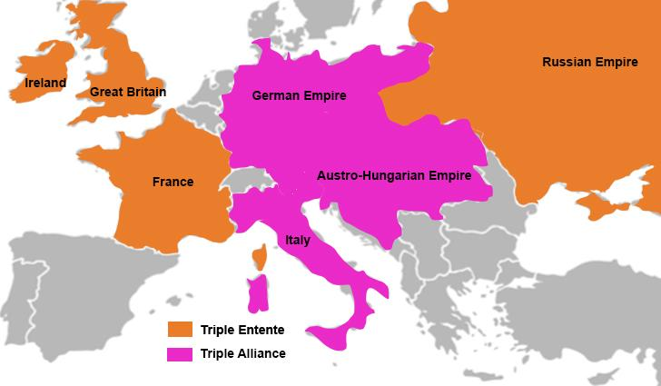
Title: Militarism and the Arms Race
LO: How did militarism and the arms race increase tensions in Europe before 1914?
Title: Militarism and the Arms Race
Key Enquiry Question: What were the causes of WW1, and how did different factors contribute to the outbreak of the conflict?
Last Lesson: Name 2 ways the Triple Entente and the Triple Alliance were the same, and 2 ways they were different.
Two Lessons Ago: What does the term ‘imperialism’ mean?
Three Lessons Ago: What were some of the main tensions in Europe before 1914 that made war more likely?

Slide 2
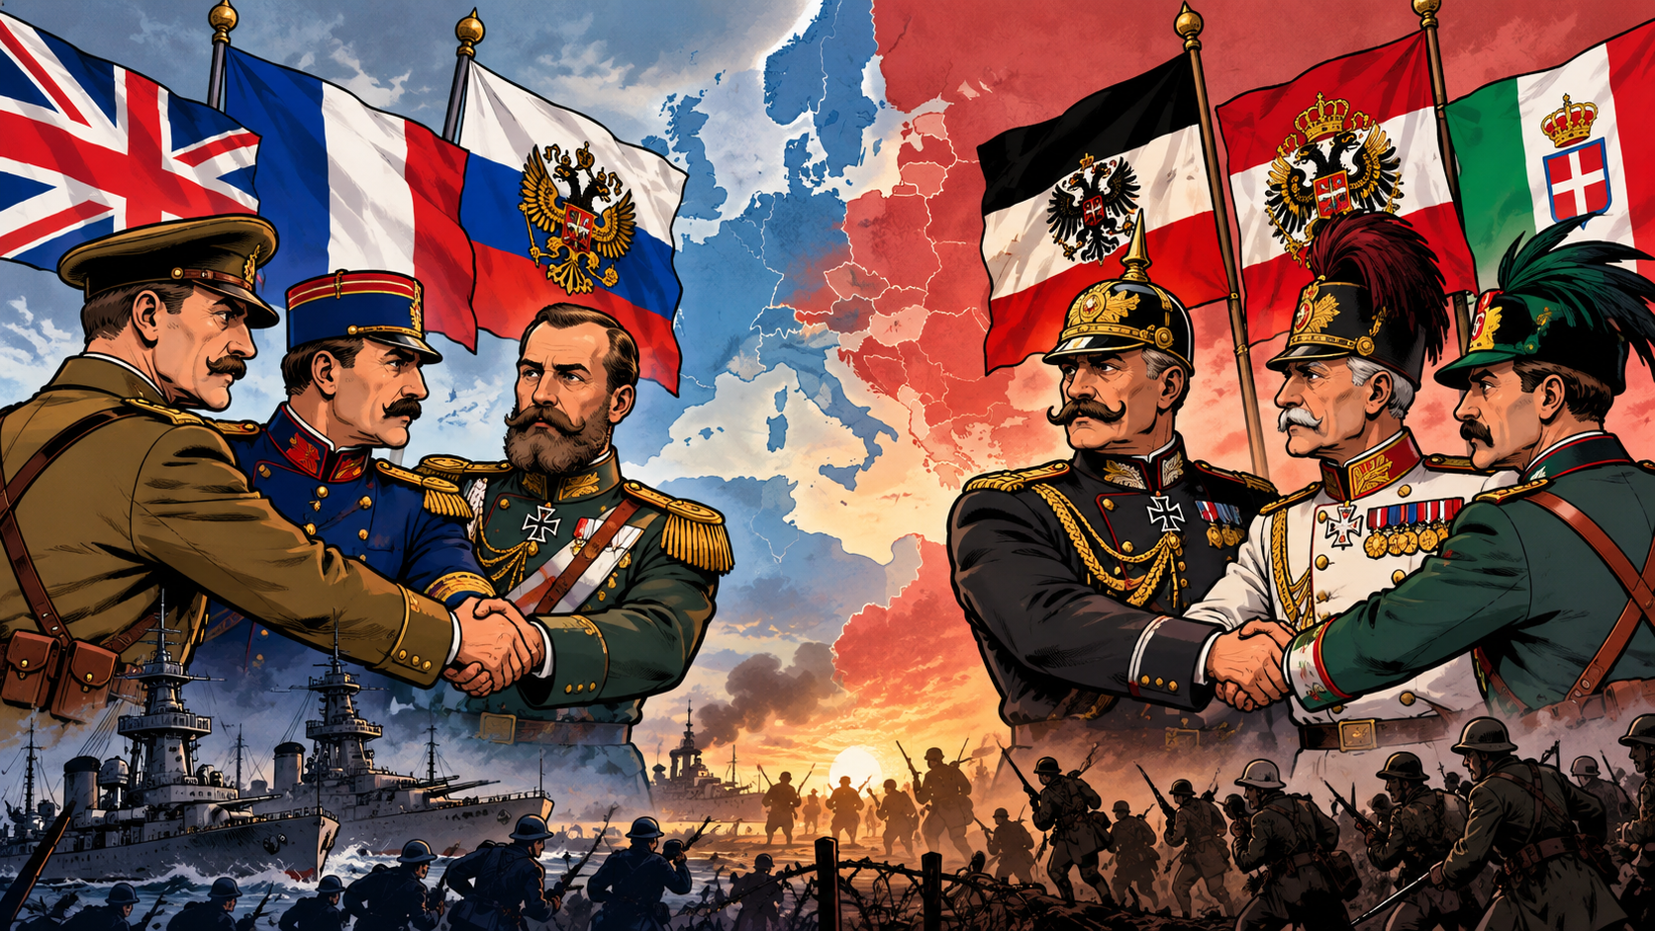
Title: Militarism and the Arms Race
LO: How did militarism and the arms race increase tensions in Europe before 1914?
Date: Monday 19th October 2026
Title: Militarism and the Arms Race
Key Enquiry Question: What were the causes of WW1, and how did different factors contribute to the outbreak of the conflict?
Success Criteria:
🧭 Meeting:
Can identify key features of militarism, preventive war and conscription before 1914.
🔎 Exceeding:
Can explain how military expansion and preventive war increased tensions between European countries.
🧠 Mastering:
Can interpret military statistics to analyse how the arms race increased tensions in Europe before 1914.

Slide 3
Title: Militarism and the Arms Race
LO: How did militarism and the arms race increase tensions in Europe before 1914?
What were the main causes of WW1?
Key Enquiry Question: What were the causes of WW1, and how did different factors contribute to the outbreak of the conflict?
Remember the acronym MAINS:
M is for Militarism
A is for the Alliance System
I is for Imperialism
N is for Nationalism
S is for Significant Individuals

Slide 4




Title: Militarism and the Arms Race
LO: How did militarism and the arms race increase tensions in Europe before 1914?
Keywords:
Key Enquiry Question: What were the causes of WW1, and how did different factors contribute to the outbreak of the conflict?
Arms Race 军备竞赛 무기 경쟁 |  | When two or more countries try to make their armies stronger by getting more soldiers, weapons and new technology to gain power over each other.
Dreadnought 드레드노트 |  | A battleship with oil-powered (diesel) engines that made it faster and more powerful than any other battleship at the time.
Militarism 军国主义 군국주의 |  | The idea that a country should have a strong army and be ready to use it to protect or improve its interests.
Conscription 征兵 징병 |  | A system requiring men to serve in the armed forces for a set period of time.

Slide 5
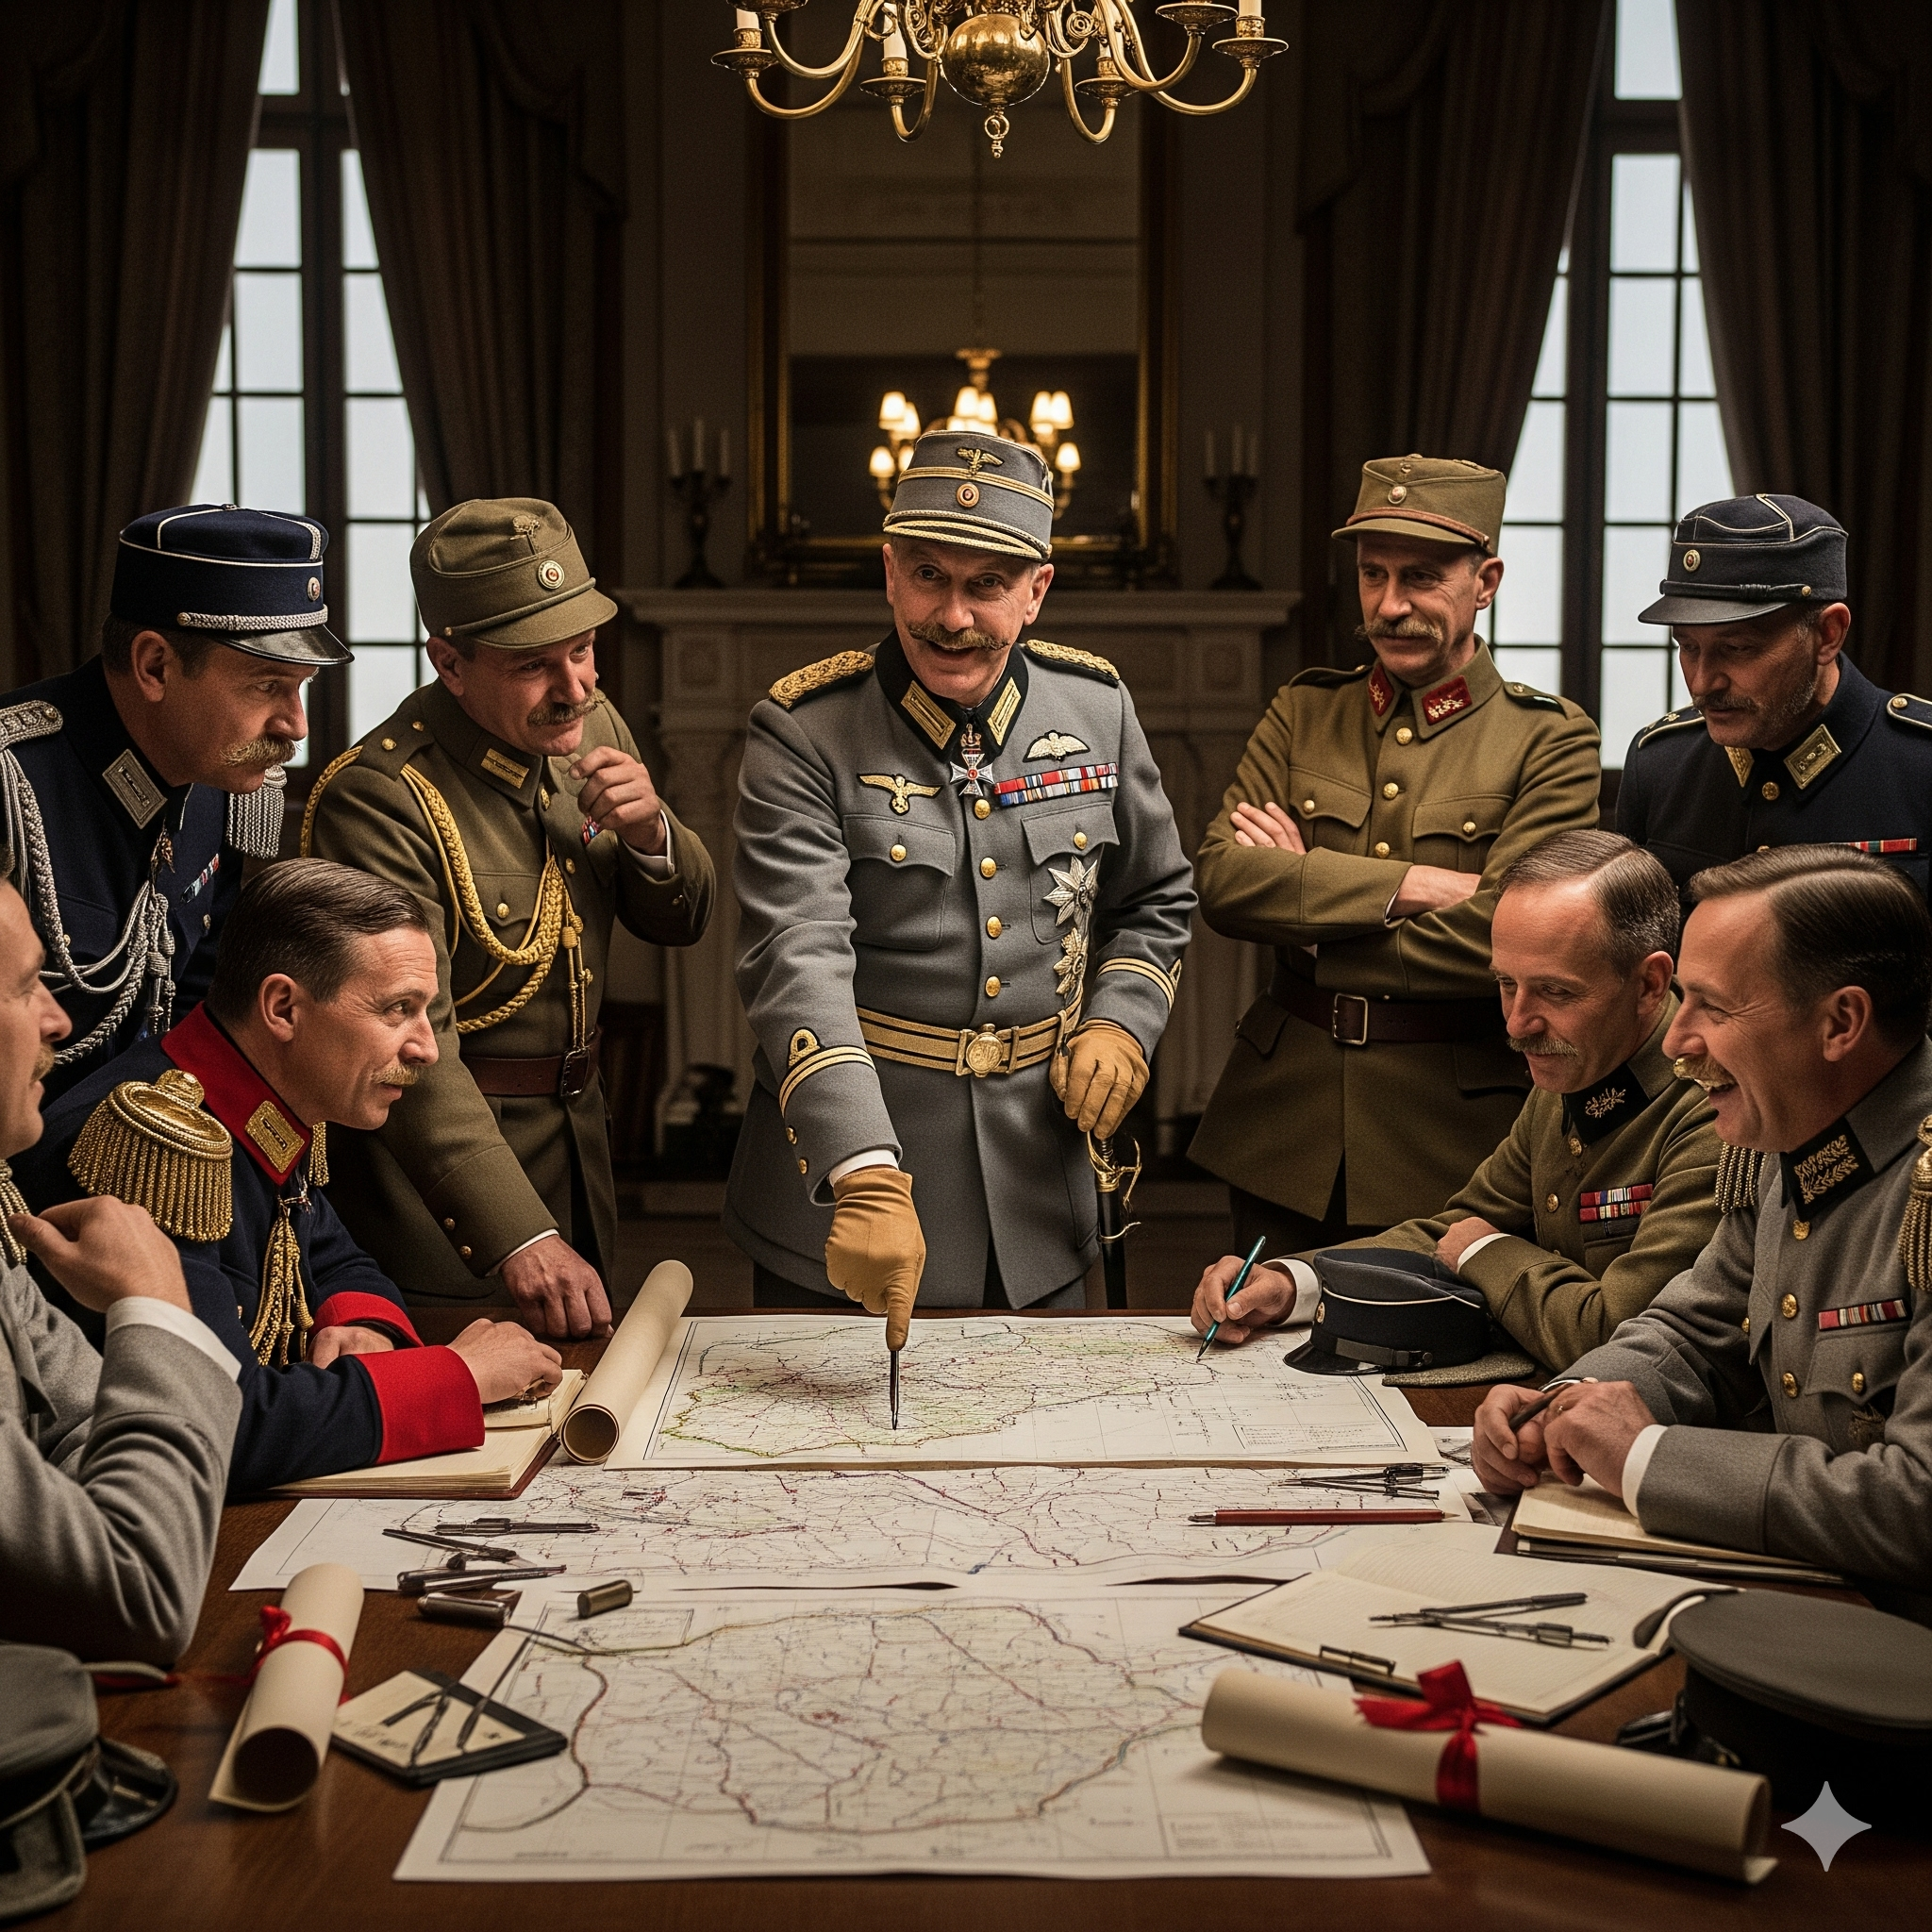
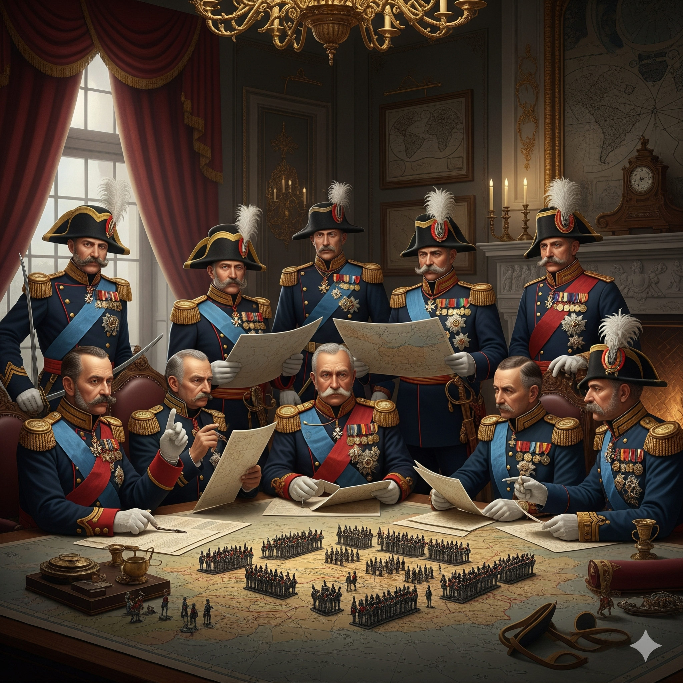
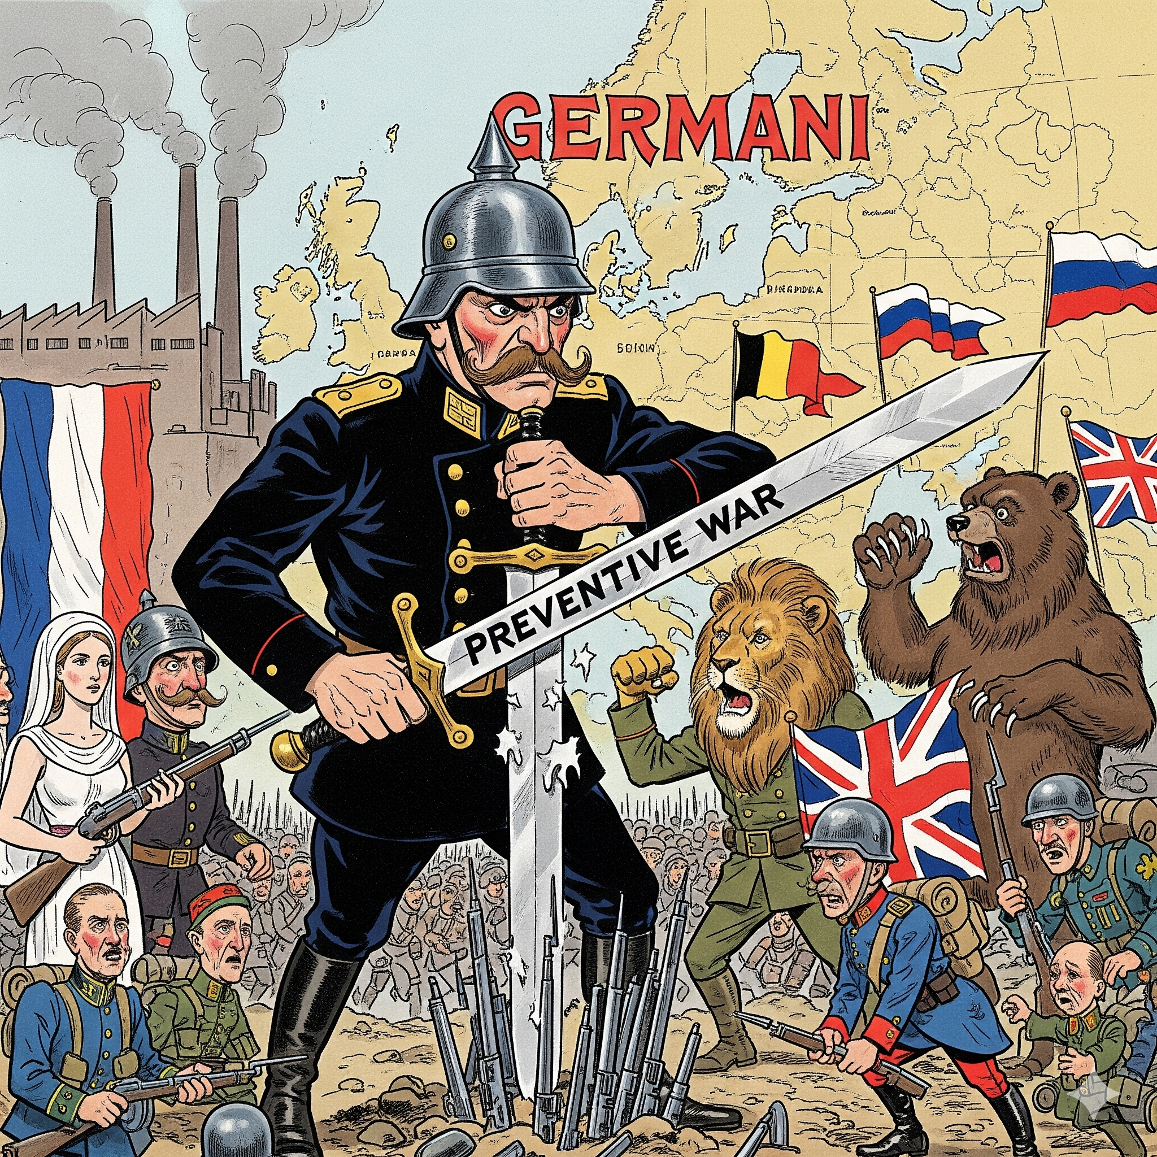
Title: Militarism and the Arms Race
LO: How did militarism and the arms race increase tensions in Europe before 1914?
A Preventative War? 예방 전쟁? 预防性战争？
Before WWI, all major European countries had plans to attack their enemies. Leaders were confident they could win quickly. Military leaders expected their armies to succeed, so governments did not do enough to maintain peace. As a result, small disagreements between countries were allowed to become more serious.
Military leaders did not fully understand modern warfare. They failed to realise that new weapons made both attacking and defending stronger, meaning wars could last much longer. They also underestimated the damage a long war could cause to a country's economy.
Many historians argue that Germany's military plans aimed at a preventive war. This meant attacking first to stop another country from attacking. However, this approach made war more likely, because other countries feared a German attack and began building up their own armies to protect themselves.

Slide 6
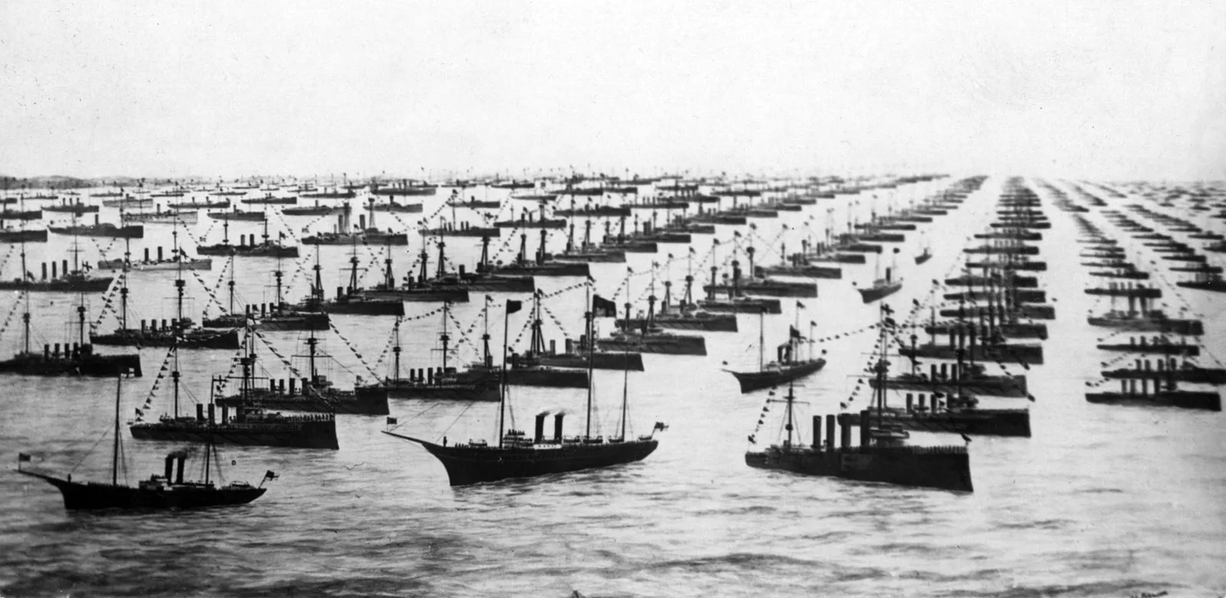
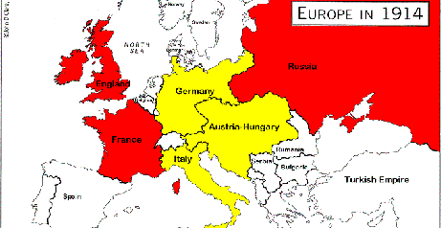
Title: Militarism and the Arms Race
LO: How did militarism and the arms race increase tensions in Europe before 1914?
Why Did Britain Need A Strong Navy?
Activity:
One minute to think about your answer
One minute to discuss with your partner
One minute to note your answer before feeding back to the class
Britain was an island – it needed a navy to protect its coastline
To protect her vast overseas Empire
Britain relied on trade with other nations – it needed the navy to protect its trade ships

Slide 7
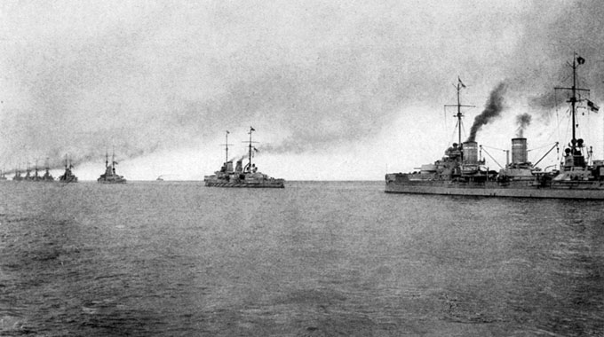
Title: Militarism and the Arms Race
LO: How did militarism and the arms race increase tensions in Europe before 1914?
Why Did Germany Expand Their Navy?
Activity:
One minute to think about your answer
One minute to discuss with your partner
One minute to note your answer before feeding back to the class
Wilhelm II was jealous of Britain’s power and Empire – he wanted Germany to become just as powerful
He claimed that since Germany had an Empire, it needed a large navy to protect it.

Slide 8
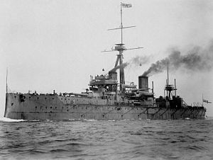
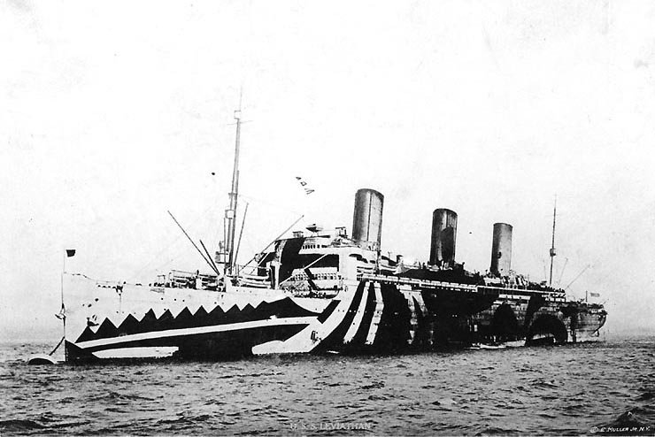
Title: Militarism and the Arms Race
LO: How did militarism and the arms race increase tensions in Europe before 1914?
Dreadnoughts & Dazzle Ships
In 1906, the British military launched the HMS Dreadnought, the most powerful navy ship ever made. Germany considered this ship to be a threat and rapidly developed its own powerful ships to rival those of Britain’s navy.
During World War I, German U-boats (submarines) threatened Britain’s merchant ships carrying food and supplies. In 1917, artist and naval volunteer Norman Wilkinson invented "dazzle camouflage," painting ships in bold patterns and bright colours to confuse enemies about their speed and direction. Although there was no clear proof it worked, crews felt safer and while Britain stopped using it after the war, the US used dazzle ships again in World War II.

Slide 9






Title: Militarism and the Arms Race
LO: How did militarism and the arms race increase tensions in Europe before 1914?
Germany’s Militarism and Preventative War
Activity: Guided Reading - Read the source on ‘Germany’s Militarism and Preventative War‘ to answer the questions on your activity sheet.
Look carefully at your completed table.
Which European country had the largest percentage increase in army and navy numbers between 1890 and 1914?
Choose two countries and compare their percentage increases.
Explain one reason why countries might have wanted to increase the size of their militaries.
“Building a stronger military made European countries safer, not more likely to go to war.”
How far do you agree?
In your answer:
Use evidence from your percentage-change table.
Explain why countries wanted stronger armies.
Explain how military expansion could make other countries feel threatened.
Reach a justified conclusion.
Notes:
https://www.youtube.com/watch?v=hrc6FdWY-9s

Slide 10

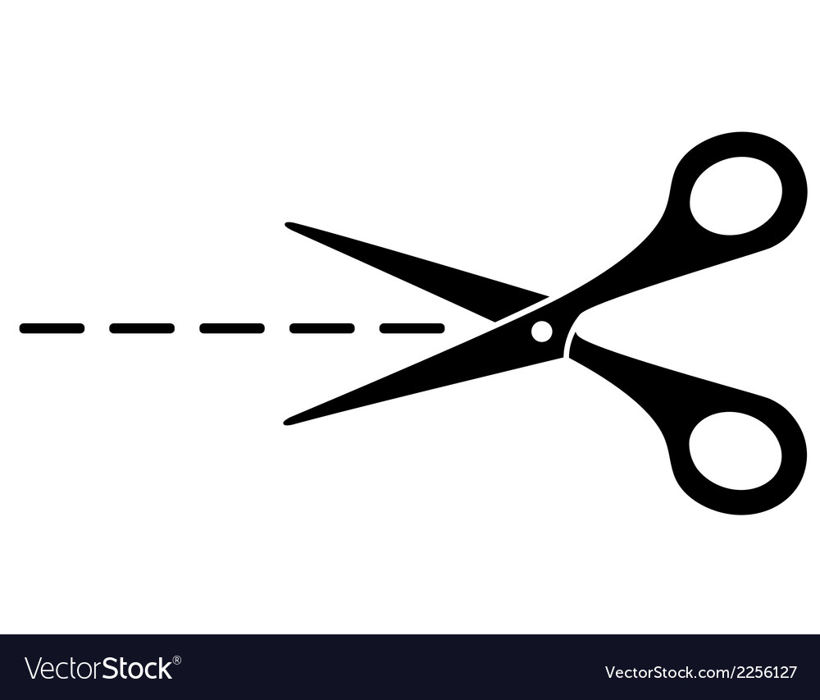
Germany’s Militarism and Preventative War
1. In 1914, Germany planned a preventive war, which meant ___________________________
___________________________________________________________________
2. Germany feared being surrounded by France and Russia because ____________________
______________________________________________________________________________________________________________________________________
3. The Zabern affair in 1913 showed that ________________________________________
______________________________________________________________________________________________________________________________________
4. Unlike France and Britain, Germany’s military was ________________________________
___________________________________________________________________
5. Kaiser Wilhelm II’s impulsive and undiplomatic behaviour meant that __________________
___________________________________________________________________
Army and Navy numbers of the main powers before WWI – shown in thousands
Country | 1890 | 1914 | % increase 1890 - 1914
Russia | 677 | 1352 | 99.7%
France | 542 | 910
Germany | 426 | 891
Britain | 367 | 532
Aus-Hung | 246 | 444
Italy | 216 | 345
Japan | 71 | 306
USA | 34 | 164
% Change = (1914 number - 1890 number) / 1890 number x 100
Change = 1352 - 677 = 675
Original starting number = 677
(675 / 677) x 100 = 0.997 x 100 = 99.7% (Round Up!)
Germany, France, and Russia show bigger percentage increases because _________
___________________________________________________________________________________________________________________________________________________________
Percentage change helps us understand the data because _____________________
_____________________________________________________________________________________________
The arms race made tensions in Europe worse before WWI because ______________
____________________________________________________________________________________________________________________________________________________________________________________________________________________________________________________

Slide 11

Title: Militarism and the Arms Race
LO: How did militarism and the arms race increase tensions in Europe before 1914?
Germany’s Militarism and Preventative War
In 1914, Germany planned a preventive war, which meant… attacking first to stop other countries from attacking them.
Germany feared being surrounded by France and Russia because… Russia was modernising its army with France’s support, making both neighbours strong.
The Zabern affair in 1913 showed that… the German army had too much power and could act without punishment, even when breaking the law.
Unlike France and Britain, Germany’s military was… allowed to act on its own, without being fully controlled by the government.
Kaiser Wilhelm II’s impulsive and undiplomatic behaviour meant that… other countries distrusted Germany, which increased the chances of war.

Slide 12
Title: Militarism and the Arms Race
LO: How did militarism and the arms race increase tensions in Europe before 1914?
Germany’s Militarism and Preventative War
Country | 1890 | 1914 | % increase 1890 - 1914
Russia | 677 | 1352 | 99.7%
France | 542 | 910 | 67.9%
Germany | 426 | 891 | 109.2%
Britain | 367 | 532 | 45%
Aus-Hung | 246 | 444 | 80.5%
Italy | 216 | 345 | 59.7%
Japan | 71 | 306 | 331%
USA | 34 | 164 | 382.4%
3. Germany, France, and Russia show bigger percentage increases because…
They were in direct rivalry with each other and wanted to be stronger than their neighbours.
Germany feared being surrounded by France and Russia, so it built up its forces quickly.
France and Russia increased their armies to balance Germany’s growing power.
4. Percentage change helps us understand the data because…
It shows how much a country’s army or navy grew compared to its starting size.
It makes it easier to compare countries of different sizes fairly.
It shows growth more clearly than just looking at the numbers.

Slide 13




Title: Militarism and the Arms Race
LO: How did militarism and the arms race increase tensions in Europe before 1914?
True Or False
1. Germany believed that France and Russia were becoming less powerful before World War I.
2. All major European countries had military plans in case war broke out before 1914.
3. Britain developed a strong navy to protect its coastline, empire and overseas trade.
4. The launch of HMS Dreadnought in 1906 encouraged Germany to develop more powerful battleships.
5. Conscription allowed European countries to build large, trained armies before World War I.
6. Germany’s plans for preventive war helped reduce fear and distrust between European countries.
Notes:
https://dashboard.blooket.com/set/68b8d0887ef53e8c73be158f

Slide 14

Title: Militarism and the Arms Race
LO: How did militarism and the arms race increase tensions in Europe before 1914?
Notes:
https://dashboard.blooket.com/set/68c90d70bd693d7aec34c3c3

Slide 15
Title: Militarism and the Arms Race
LO: How did militarism and the arms race increase tensions in Europe before 1914?
Date: Title: Militarism and the Arms Race
Key Enquiry Question: What were the causes of WW1, and how did different factors contribute to the outbreak of the conflict?
Success Criteria:
🧭 Meeting:
Can identify information from historical sources about military competition before WWI.
🔎 Exceeding:
Can explain how historical sources show that militarism and the arms race increased tensions between European countries.
🧠 Mastering:
Can use evidence from historical sources and own knowledge to analyse how militarism and the arms race made a wider European war more likely in 1914.

Slide 16
Title: Militarism and the Arms Race
LO: How did militarism and the arms race increase tensions in Europe before 1914?
What were the main causes of WW1?
Key Enquiry Question: What were the causes of WW1, and how did different factors contribute to the outbreak of the conflict?
Remember the acronym MAINS:
M is for Militarism
A is for the Alliance System
I is for Imperialism
N is for Nationalism
S is for Significant Individuals

Slide 17
Title: Militarism and the Arms Race
LO: How did militarism and the arms race increase tensions in Europe before 1914?
Keywords:
Key Enquiry Question: What were the causes of WW1, and how did different factors contribute to the outbreak of the conflict?
Arms Race |  | When two or more countries try to make their armies stronger by getting more soldiers, weapons and new technology to gain power over each other.
Dreadnought |  | A battleship with oil-powered (diesel) engines that made it faster and more powerful than any other battleship at the time.
Militarism |  | The idea that a country should have a strong army and be ready to use it to protect or improve its interests.
Conscription |  | A system requiring men to serve in the armed forces for a set period of time.

Slide 18

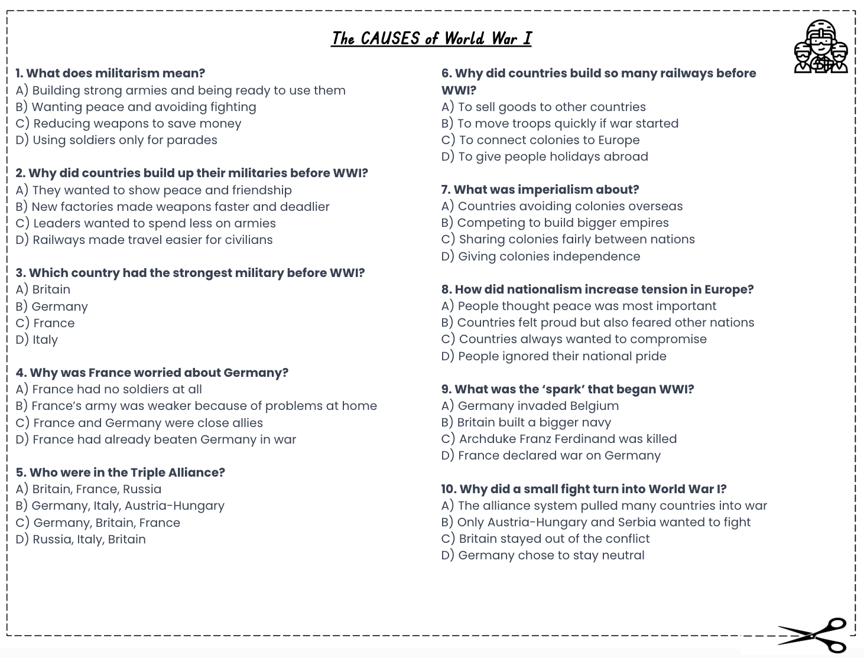
Title: Militarism and the Arms Race
LO: How did militarism and the arms race increase tensions in Europe before 1914?
A Preventative War?
Activity: Complete the multiple choice questions whilst watching the video:
The CAUSES of World War I
Notes:
https://www.youtube.com/watch?v=cLR-bgx-Egs

Slide 19

Title: Militarism and the Arms Race
LO: How did militarism and the arms race increase tensions in Europe before 1914?
A Preventative War?
1. A) Building strong armies and being ready to use them
2. B) New factories made weapons faster and deadlier
3. D) Germany
4. B) France’s army was weaker because of problems at home
5. C) Germany, Italy, Austria-Hungary
6. D) To move troops quickly if war started
7. A) Competing to build bigger empires
8. B) Countries felt proud but also feared other nations
9. C) Archduke Franz Ferdinand was killed
10. A) The alliance system pulled many countries into war
GREEN PEN YOUR ANSWERS

Slide 20
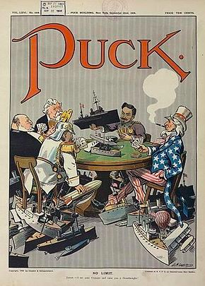
Title: Militarism and the Arms Race
LO: How did militarism and the arms race increase tensions in Europe before 1914?
Analysing Historical Sources: Puck Cartoon
Identify — What can you see?
Explain — What message does it show?
Think — Why might the creator want people to think this?
Use evidence — Which details support your answer?
Historical Context — Before 1914
Before the First World War, powerful countries such as Britain and Germany competed to build stronger navies. This naval arms race increased fear and tension across Europe.

Slide 21
Title: Militarism and the Arms Race
LO: How did militarism and the arms race increase tensions in Europe before 1914?
Analysing Historical Sources: Puck Cartoon
IDENTIFY — What can you see?
Figures representing powerful countries sit around a table covered with warships. Uncle Sam represents the USA.
EXPLAIN — What message does it show?
Countries are competing to build stronger navies, increasing tensions.
THINK — Why was it created?
The creator may want people to worry about the growing naval arms race.
USE EVIDENCE — Which details support your answer?
The many warships show competition and suggests the arms race could continue without stopping.

Slide 22

Title: Militarism and the Arms Race
LO: How did militarism and the arms race increase tensions in Europe before 1914?
Analysing Historical Sources: Causes of WW1
Activity: Using Sources A and B, identify the strongest navy, explain how competition increased tensions, and assess whether the Kaiser’s arguments would reassure or worry Britain.
Source A - The Naval Strength of the Powers in 1914
Using evidence to make a judgement
Which country had the most Dreadnoughts by 1914?
Which alliance had the most Dreadnoughts by 1914?
How might this naval competition have increased tensions 紧张关系 긴장?
Source B - Daily Telegraph Interview
Understanding the message and purpose
What relationship did the Kaiser want with Britain?
Why did Germany need a large navy, according to the Kaiser?
How did Japan and China support his argument?
Do you think the Kaiser’s explanation would reassure 안심시켜 주세요 安慰 Britain or make it more suspicious可疑 수상하다 of Germany?
Using the sources and your own knowledge, explain how militarism and the arms race contributed to the outbreak of the First World War.
Notes:
https://www.youtube.com/watch?v=pqs0SCW1_xI

Slide 23
Activity: Using Sources A and B, identify the strongest navy, explain how competition increased tensions, and assess whether the Kaiser’s arguments would reassure or worry Britain.
Source B
Source B
1908년 영국 신문 《데일리 텔레그래프(The Daily Telegraph)》에 실린 독일 황제 빌헬름 2세와의 인터뷰 발췌문
황제는 영국과 평화로운 관계를 유지하고 싶으며, 영국인들이 왜 자신을 불신하는지 이해할 수 없다고 말했다. 그는 길드홀(Guildhall)에서 했던 연설을 상기시키며, 자신의 가장 큰 소망 중 하나가 영국과 좋은 관계를 유지하며 살아가는 것이라고 약속했다고 강조했다. 또한 자신이 약속을 어긴 적이 있었는지 물었다.
황제는 독일이 대규모 해군을 건설하고 있다는 사실을 인정했지만, 그것이 영국을 위협하기 위한 것은 아니라고 설명했다. 대신 독일은 세계 곳곳에서 무역을 펼치는 젊고 성장하는 제국이므로 이를 보호할 필요가 있다고 주장했다. 그는 멀리 떨어진 바다에서도 독일의 이익을 지키기 위해서는 강력한 해군이 필요하다고 말했다.
그는 일본의 부상과 중국이 잠재력을 발휘하기 시작할 가능성을 언급하며, 태평양에서 미래의 도전에 대비하기 위해 모든 유럽 열강이 준비해야 한다고 주장했다. 황제는 또한 언젠가 영국이 국제 정세에서 독일 함대를 동맹국으로서 환영하게 될 수도 있다고 덧붙였다.
摘自英国《每日电讯报》1908 年对德皇威廉二世的采访
德皇表示，他希望与英国保持和平，并且不明白为什么英国人不信任他。他提醒英国人回想起自己在伦敦市政厅发表的演讲，当时他曾承诺，与英国保持良好关系是他最大的愿望之一。他还反问道，自己是否曾经违背过诺言。
德皇承认，德国正在建造一支规模庞大的海军，但他解释说，这并不是为了威胁英国。相反，他表示，德国是一个年轻且不断发展的帝国，拥有遍布世界各地的贸易，因此需要保护这些贸易。一支强大的海军是捍卫德国利益所必需的，即使是在遥远的海域也不例外。
他指出，日本的崛起以及中国未来可能的崛起，说明所有欧洲列强都应该为太平洋地区未来可能出现的挑战做好准备。德皇还补充说，有朝一日，英国甚至可能会在国际事务中欢迎德国舰队成为自己的盟友。

Slide 24
Title: Militarism and the Arms Race
LO: How did militarism and the arms race increase tensions in Europe before 1914?
Analysing Historical Sources: Causes of WW1
Source A — The Naval Strength of the Powers in 1914
1. Which country had the most Dreadnoughts by 1914?
Britain had the most Dreadnoughts, with 29, compared with Germany’s 17.
2. Which alliance had the most Dreadnoughts by 1914?
The Triple Entente (Britain, France and Russia) had the most, with 43 Dreadnoughts, compared with 21 for Germany and Austria-Hungary.
3. How might this naval competition have increased tensions?
Britain and Germany competed to build stronger navies. Britain may have seen Germany’s growing navy as a threat, while Germany wanted to protect its trade and interests. This competition could increase fear and mistrust between the countries.

Slide 25
Title: Militarism and the Arms Race
LO: How did militarism and the arms race increase tensions in Europe before 1914?
Analysing Historical Sources: Causes of WW1
Source B — Daily Telegraph Interview, 1908
1. What relationship did the Kaiser want with Britain?
The Kaiser said he wanted peace and friendly relations with Britain. He claimed that he wanted the two countries to live on good terms.
2. Why did Germany need a large navy, according to the Kaiser?
The Kaiser argued that Germany was a growing empire with worldwide trade that needed protection. He said a strong navy was necessary to defend German interests, including in distant seas.
3. How did Japan and China support his argument?
The Kaiser argued that Japan was becoming more powerful and China might also become stronger. He claimed that European countries needed strong navies to prepare for possible future challenges in the Pacific.

Slide 26
Title: Militarism and the Arms Race
LO: How did militarism and the arms race increase tensions in Europe before 1914?
Analysing Historical Sources: Causes of WW1
Source B — Daily Telegraph Interview, 1908
4. Do you think the Kaiser’s explanation would reassure 안심시켜 주세요 安慰 Britain or make it more suspicious 可疑 수상하다 of Germany?
The explanation might make Britain more suspicious of Germany. Although the Kaiser claimed that he wanted peace, Germany was building a large navy that could threaten British naval power. Britain might worry that Germany could become a rival, even if the Kaiser said that he wanted friendly relations.
Alternatively, some people might have found his explanation reasonable because Germany had overseas trade to protect. However, his assurances of peace might not have removed British concerns about Germany’s growing navy.

Slide 27
Title: Militarism and the Arms Race
LO: How did militarism and the arms race increase tensions in Europe before 1914?
Odd One Out
What where the main reasons leaders failed to take responsibility for peace before 1914?
a) They kept building bigger armies and navies
b) They signed alliances that could drag more countries into war
c) They worked hard together to avoid conflict
d) They competed for colonies and power
Notes:
https://dashboard.blooket.com/set/68b116266e3af35fc52bd327

Slide 28
Title: Militarism and the Arms Race
LO: How did militarism and the arms race increase tensions in Europe before 1914?
Odd One Out
What where the main reasons countries showed little respect to each other before 1914?
a) Countries reduced their armies to show goodwill
b) Alliances made countries suspicious of each other
c) Germany tried to rival Britain’s navy
d) Leaders thought only strong nations deserved influence
Notes:
https://dashboard.blooket.com/set/68b116266e3af35fc52bd327

Slide 29
Title: Militarism and the Arms Race
LO: How did militarism and the arms race increase tensions in Europe before 1914?
Odd One Out
What where the main reasons countries did not act with honesty and integrity before 1914?
a) Leaders said they wanted peace but kept building weapons
b) Alliances were meant for defence but increased mistrust
c) Countries secretly prepared for war
d) Leaders agreed openly to limit the arms race
Notes:
https://dashboard.blooket.com/set/68b116266e3af35fc52bd327

Slide 30
Title: Militarism and the Arms Race
LO: How did militarism and the arms race increase tensions in Europe before 1914?
Odd One Out
What was the main reasons leaders lacked courage to prevent war before 1914?
a) They followed militarism instead of seeking peace
b) They feared looking weak if they reduced their armies
c) They challenged the arms race even when it was unpopular
d) They allowed alliances to control their choices
Notes:
https://dashboard.blooket.com/set/68c90d70bd693d7aec34c3c3

